Slide 1
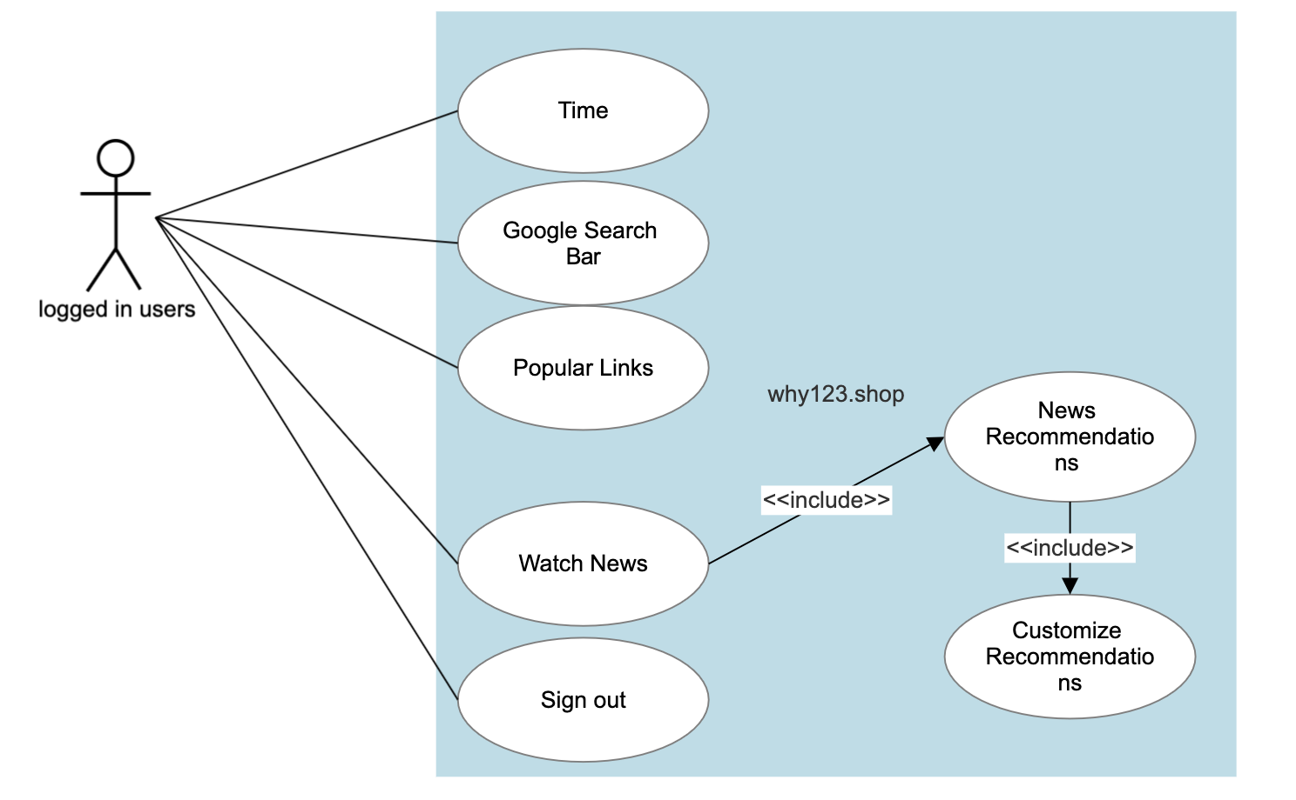
User case diagram: logged user

Slide 2
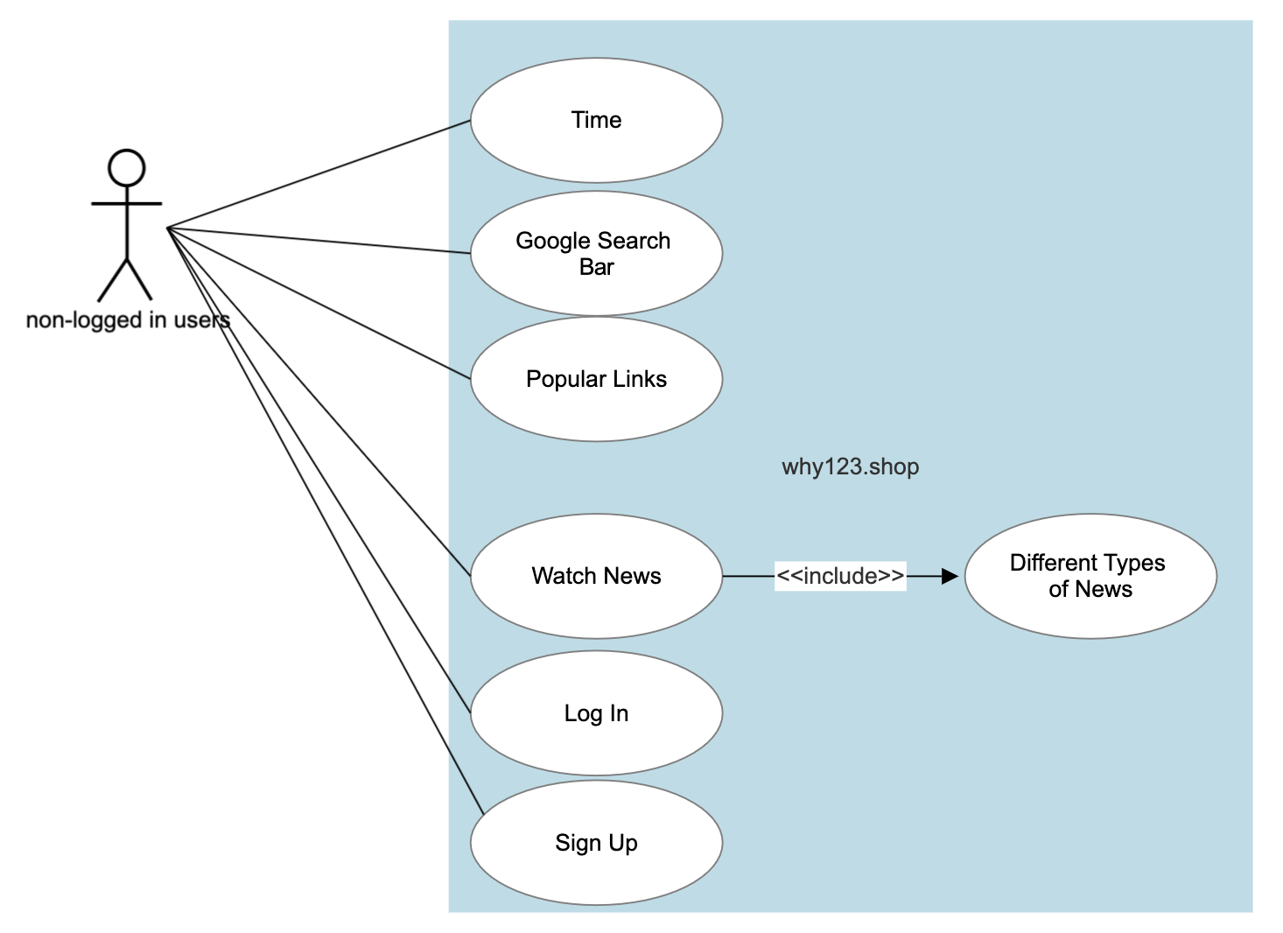
User case diagram: non-logged user

